Slide 1

Machine Learning Overview
Stephen McLaughlin
PhD Student

Slide 2
 | Feature 1 | Feature 2 | Feature 3 | Feature 4
Label A | 11.3166 | 13.1009 | 17.1638 | 1.2876
Label A | 0.0023 | 8.9224 | 7.3368 | 12.826
Label A | 13.9563 | 11.0516 | 8.5414 | 14.0572
Label A | 1.7851 | 9.1011 | 10.7928 | 4.5441
Label B | 12.0978 | 10.4598 | 5.7786 | 12.4596
Label B | 0.28 | 17.3005 | 3.7776 | 11.1616
Label B | 7.3366 | 13.3285 | 13.3285 | 17.5108
Label B | 7.1498 | 13.6181 | 13.391 | 7.3366
Label B | 10.9546 | 6.7191 | 13.0848 | 3.9394
Stephen McLaughlin / @SteveMcLaugh
Notes:
This is not an option.

Slide 3
Types of machine learning
Regression
output: a number
Classification
output: a class (i.e., category)
Stephen McLaughlin / @SteveMcLaugh
Notes:
#metadatagoals

Slide 4
Types of machine learning
Supervised learning
starting with labeled training data
Unsupervised learning
inferring relationships without class labels
Reinforcement learning
neural networks
Stephen McLaughlin / @SteveMcLaugh
Notes:
#metadatagoals

Slide 5

Stephen McLaughlin / @SteveMcLaugh
Notes:
This is not an option.

Slide 6
Model
Training set
Algorithm
Validation set
Test set
Real world
Stephen McLaughlin / @SteveMcLaugh
Notes:
#metadatagoals

Slide 7
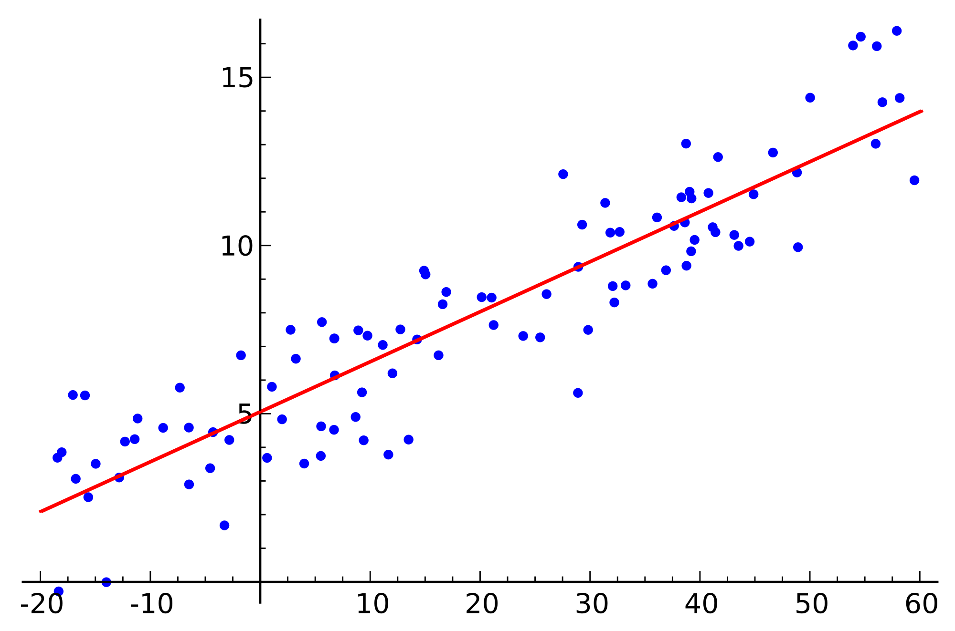
Some key supervised learning algorithms
Linear regression
numbers in, numbers out
Stephen McLaughlin / @SteveMcLaugh
Notes:
https://commons.wikimedia.org/wiki/File:Linear_regression.svg

Slide 8
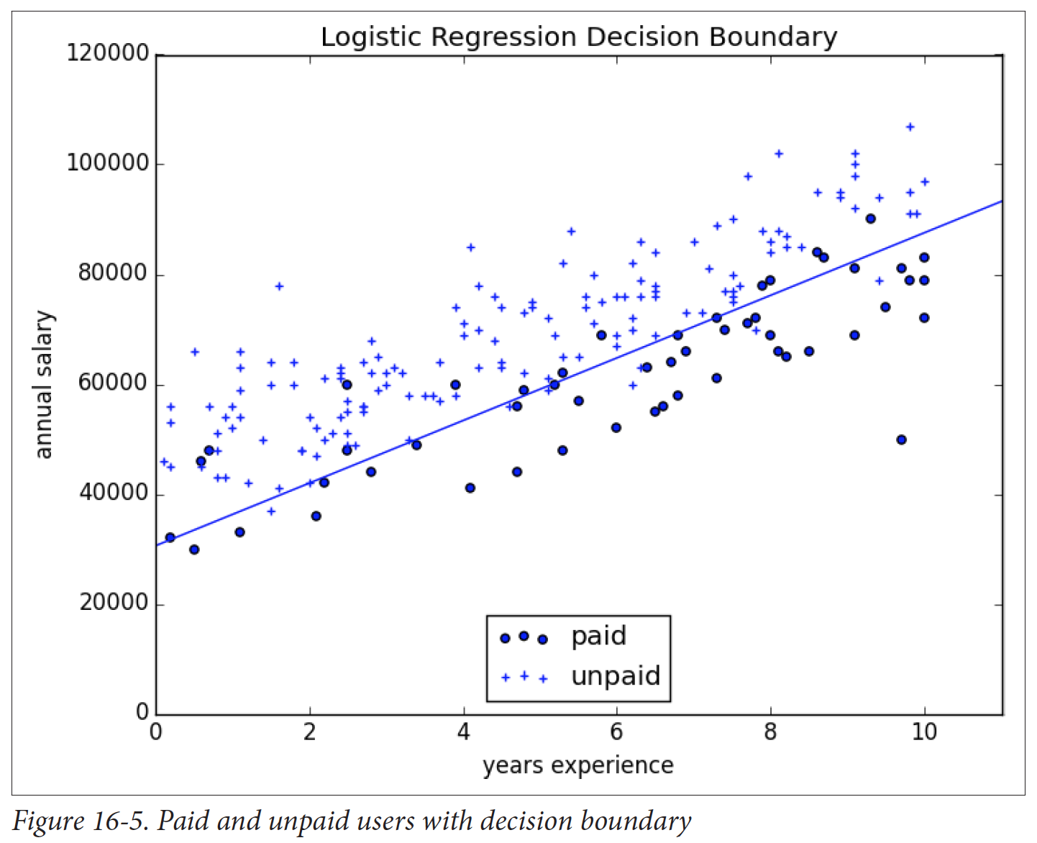
Logistic regression
prone to overfitting (training data not representative of real world)
Grus 2015
Stephen McLaughlin / @SteveMcLaugh
Notes:
Gradient boosting is a version of decision trees ... like they cut off the teee at some point?Both random forest and gradient boosting are optimization of decision trees

Slide 9
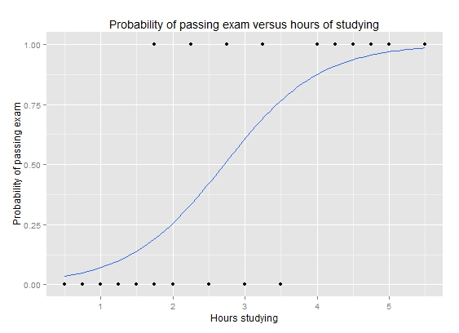
Logistic Regression
numbers in, classes out
or numbers + classes in, classes out
Stephen McLaughlin / @SteveMcLaugh
Notes:
https://en.wikipedia.org/wiki/Logistic_regression#/media/File:Exam_pass_logistic_curve.jpeg

Slide 10
K nearest neighbor
Grus 2015
Stephen McLaughlin / @SteveMcLaugh
Notes:
#metadatagoals

Slide 11
K nearest neighbor
the curse of dimensionality
intuitive, but not very efficient
Grus 2015
Stephen McLaughlin / @SteveMcLaugh
Notes:
#metadatagoals

Slide 12
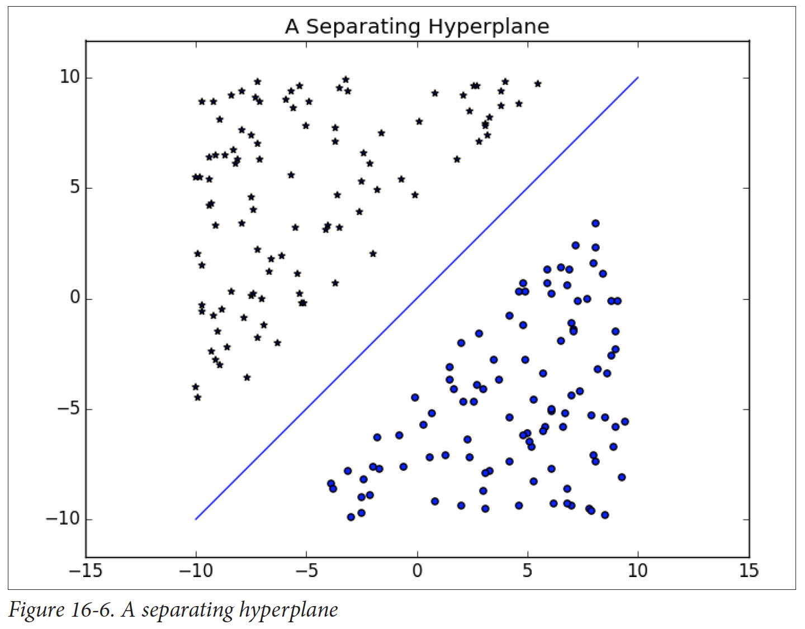
Support
vector
machine
(SVM)
Fast, cheap, and pretty good
Your #1 go-to
Grus 2015
Stephen McLaughlin / @SteveMcLaugh
Notes:
SVM
"This is the idea behind the support vectormachine, which finds the hyperplane that maximizes the distance to the nearest pointin each class (Figure 16-6)."- data science from scratch

Slide 13
Decision
trees
Slower than SVMs
Highly interpretable results
Random forests and gradient boosting are improved variations
Credit: Grus 2015
Stephen McLaughlin / @SteveMcLaugh
Notes:
#metadatagoals

Slide 14
Gaussian
mixture
models
Good for reasoning about shades of gray
Credit: Yu Zhu
Stephen McLaughlin / @SteveMcLaugh
Notes:
#metadatagoals

Slide 15
Neural networks
Credit: Wikimedia Commons
Stephen McLaughlin / @SteveMcLaugh
Notes:
#metadatagoals

Slide 16
Neural networks
“The future”
Output not interpretable
Slow, expensive, steep learning curve
Credit: Wikimedia Commons
Stephen McLaughlin / @SteveMcLaugh
Notes:
#metadatagoals

Slide 17
Stephen McLaughlin / @SteveMcLaugh

Slide 18
 | Feature 1 | Feature 2 | Feature 3 | Feature 4
Label A | 11.3166 | 13.1009 | 17.1638 | 1.2876
Label A | 0.0023 | 8.9224 | 7.3368 | 12.826
Label A | 13.9563 | 11.0516 | 8.5414 | 14.0572
Label A | 1.7851 | 9.1011 | 10.7928 | 4.5441
Label B | 12.0978 | 10.4598 | 5.7786 | 12.4596
Label B | 0.28 | 17.3005 | 3.7776 | 11.1616
Label B | 7.3366 | 13.3285 | 13.3285 | 17.5108
Label B | 7.1498 | 13.6181 | 13.391 | 7.3366
Label B | 10.9546 | 6.7191 | 13.0848 | 3.9394
Stephen McLaughlin / @SteveMcLaugh
Notes:
This is not an option.

Slide 19
Stephen McLaughlin / @SteveMcLaugh

Slide 20
Stephen McLaughlin / @SteveMcLaugh

Slide 21
Stephen McLaughlin / @SteveMcLaugh

Slide 22
Stephen McLaughlin / @SteveMcLaugh

Slide 23
Bottlenecks to wide application
Compute time
Stephen McLaughlin / @SteveMcLaugh

Slide 24
Bottlenecks to wide application
Compute time
Existing metadata quality
Stephen McLaughlin / @SteveMcLaugh

Slide 25
Bottlenecks to wide application
Compute time
Existing metadata quality
Human ML training time
Stephen McLaughlin / @SteveMcLaugh

Slide 26
Bottlenecks to wide application
Compute time
Existing metadata quality
Human ML training time
Technical literacy
Stephen McLaughlin / @SteveMcLaugh

Slide 27
Bottlenecks to wide application
Compute time
Existing metadata quality
Human ML training time
Technical literacy
Copyright restrictions
Stephen McLaughlin / @SteveMcLaugh

Slide 28
Changes in the past 5 years
Processors are faster.
Storage is cheaper.
VPSes are friendlier.
More and better core ML tools.
More and better high-level wrappers.
GitHub and Stack Overflow are much larger.
Stephen McLaughlin / @SteveMcLaugh
Notes:
And I’m gonna be ... permit me to deal in straw men for a sec. This isn’t even polemical, it’s just a matter of fact.

Slide 29
Stephen McLaughlin / @SteveMcLaugh
Notes:
SVM
"This is the idea behind the support vectormachine, which finds the hyperplane that maximizes the distance to the nearest pointin each class (Figure 16-6)."- data science from scratch

Slide 30
Stephen McLaughlin / @SteveMcLaugh

Slide 31
Stephen McLaughlin / @SteveMcLaugh
Notes:
This is not an option.

